Slide 1
Motor Protection -
Gap Analysis

Slide 2
SWOT Analysis
Strength Over Current (Inverse time curves) Differential Protection (DC restrain) Thermal Overload (ambient temperature) Load Profile Recording (click of the real clock) | Weakness Differential Protection Thermal Overload Flexi Curve (GE) Flexible Protection (SIEMENS) Application Coverage – Intermittent load application note (SEL)
Opportunities Variable Frequency Drive Protection as Unit (SEL,GE ) Backspin or Coast Down Protection Inter Turn Short Circuit Protection Transient or Intermittent Earth Fault ( SIEMENS) Thermal O/L– Heating Behavior : Diabatic and Adiabatic Advance Monitoring and Diagnostics | Threat Rotor Broken Bar Protection Statistics Event Handling Self Test and Troubleshooting(SEL,GE) Synchronous Motor Control and Protection (GE,SEL, SIEMENS)
ABB | GE | SEL | SIEMENS
RI – RD curves Programmable curves | IAC curves I2t and I4t Flexi curves -4 nos. | - | -

Slide 3
Threat
Rotor Broken Bar Protection
Statistics
Motor Learned Data (GE)
Environmental Health Report (GE)
Motor Health Report(GE)
Data Logger(GE)
Motor Operating(SEL)
Motor Starting(SEL)
Motor Trending(SEL)
Event Handling
Event Summary Report(SEL)
Event History(SEL)
Event Reports(SEL)
Self Test and Troubleshooting(SEL,GE)
Synchronous Motor Control and Protection (GE,SEL, SIEMENS)

Slide 4
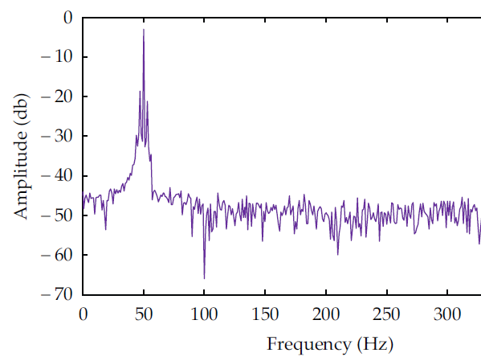
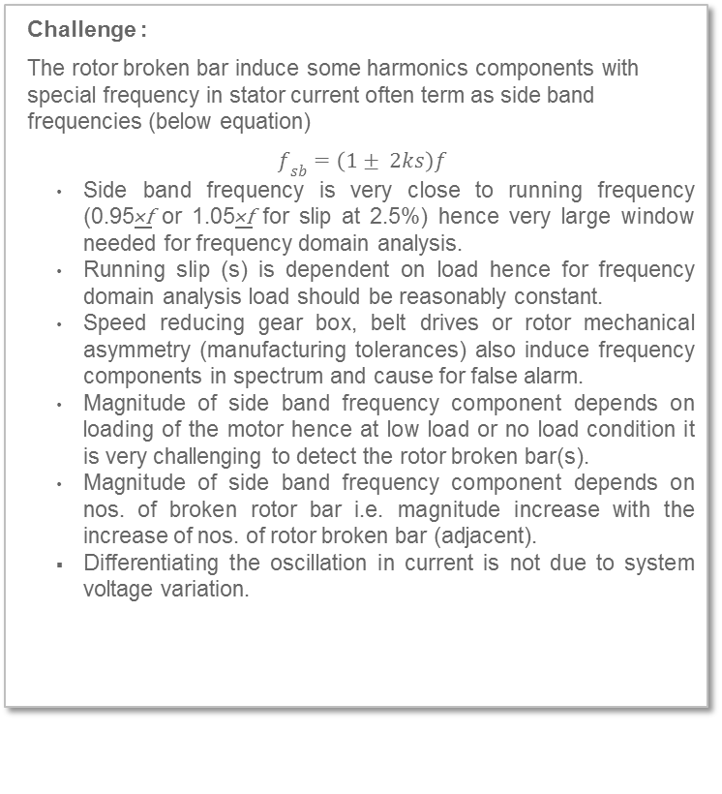
Threat
Rotor Broken Bar Protection ( SEL,GE)
Challenge :
The rotor broken bar induce some harmonics components with special frequency in stator current often term as side band frequencies (below equation)
$f_{sb}=\left(1± 2ks\right)f$
Side band frequency is very close to running frequency (0.95×f or 1.05×f for slip at 2.5%) hence very large window needed for frequency domain analysis.
Running slip (s) is dependent on load hence for frequency domain analysis load should be reasonably constant.
Speed reducing gear box, belt drives or rotor mechanical asymmetry (manufacturing tolerances) also induce frequency components in spectrum and cause for false alarm.
Magnitude of side band frequency component depends on loading of the motor hence at low load or no load condition it is very challenging to detect the rotor broken bar(s).
Magnitude of side band frequency component depends on nos. of broken rotor bar i.e. magnitude increase with the increase of nos. of rotor broken bar (adjacent).
Differentiating the oscillation in current is not due to system voltage variation.

Slide 5
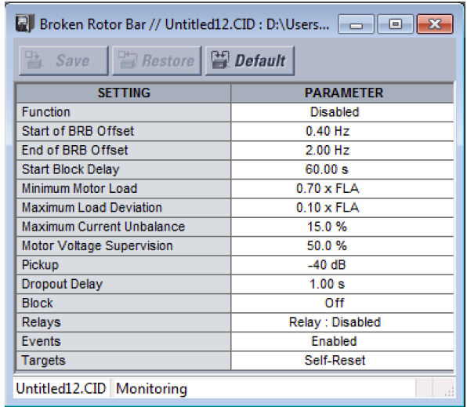
Threat
Rotor Broken Bar Protection
GE :
Approach is based on current spectrum analysis (Fast Fourier Transform). Few settings are needed as mention below.

Slide 6
Threat
Rotor Broken Bar Protection
SEL :
Setting less approach
Approach is based on current spectrum analysis (Fast Fourier Transform).
This implementation is composed of three step (Initialization, data collection for 10 sec and data processing). In data collection phase it also monitors the frequency of power system and current magnitude to ensure that the motor operate under steady state conditions. The fast Fourier transform of the samples window data and then calculate magnitude with each frequency component. Finally the average magnitudes of frequency components are compared with healthy motor threshold.
Spectrum graphic feature in ACSELERATOR QuickSet SEL-5030 software. (Rotor broken bar)
Note: As per SEL document “The Broken Rotor Bar detection algorithm cannot accurately determine the BRB spectral component when a motor is lightly loaded”.

Slide 7
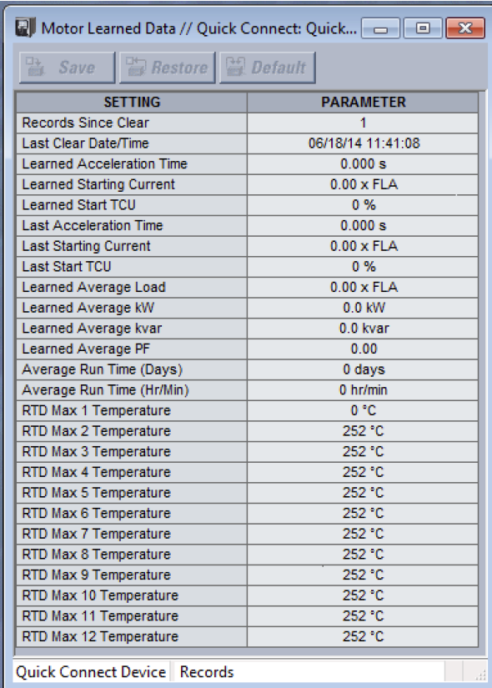
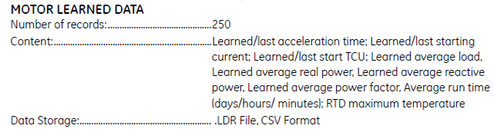
Threat
Statistics – Motor Learned Data (GE)
Setting: No of start to learn

Slide 8
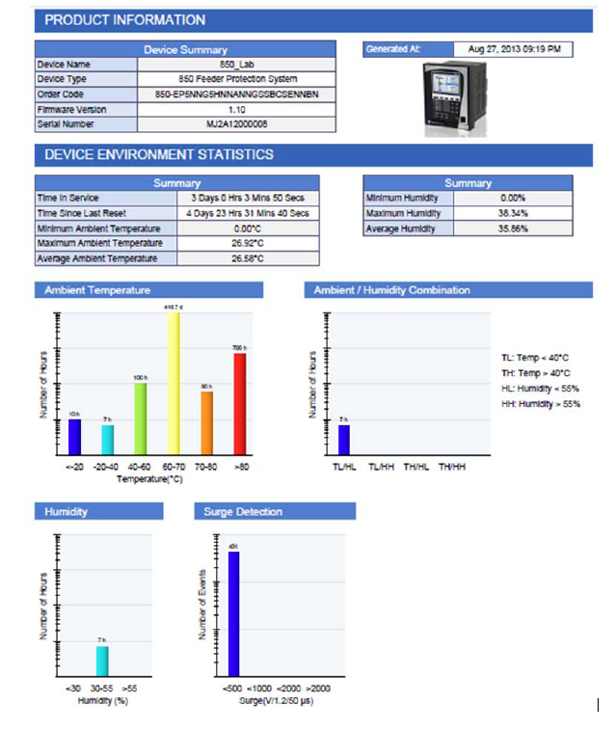
Threat
Statistics – Environmental Health Report(GE)
Use module “Environmental awareness module (patented) to record environmental data over the life of the product. The patented module measures temperature, humidity, surge pulses and accumulates the events every hour in pre-determined threshold buckets over a period of 15 years. The user can retrieve this data in the form of a histogram using Enervista Setup Software to ensure any change in the operating condition of the installed fleet is identified quickly so remedial action can be taken

Slide 9
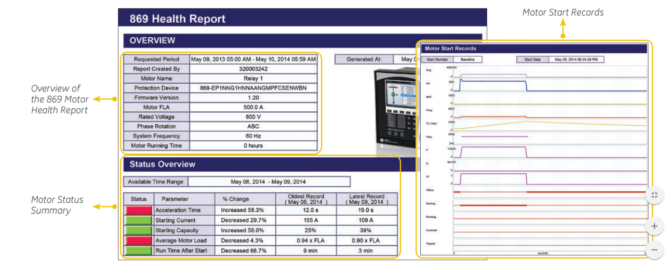
Threat
Statistics – Motor Health Report(GE)
Device over view
Status over view
Trip summary

Slide 10
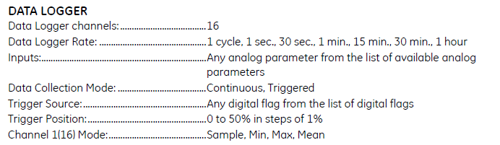
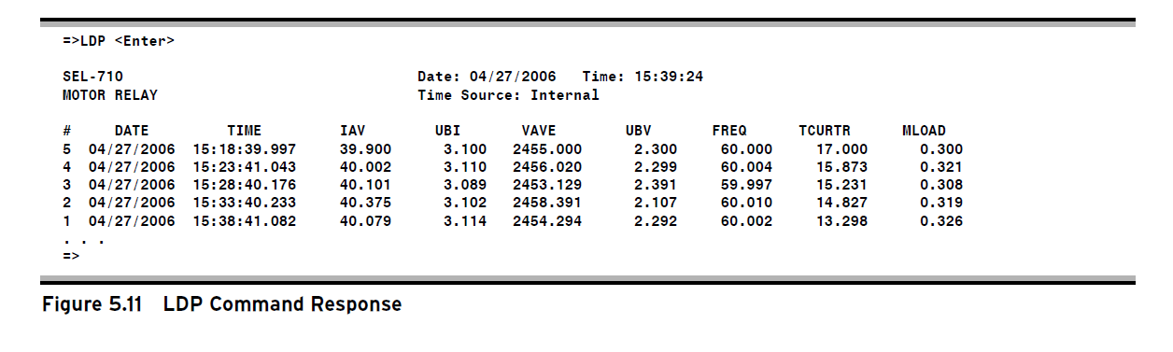
Threat
Statistics – Data Logger(GE) , Load Profiling (SEL)
GE
SEL LOAD PROFILING

Slide 11
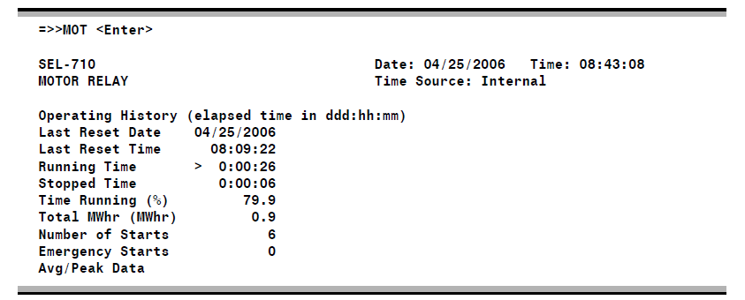
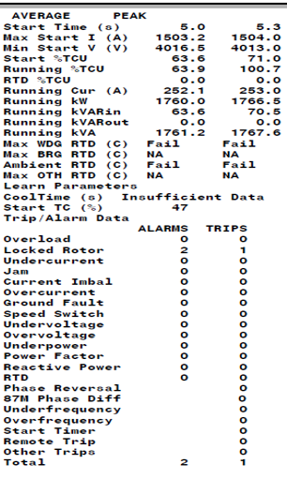
Threat
Statistics – Motor Operating(SEL)

Slide 12
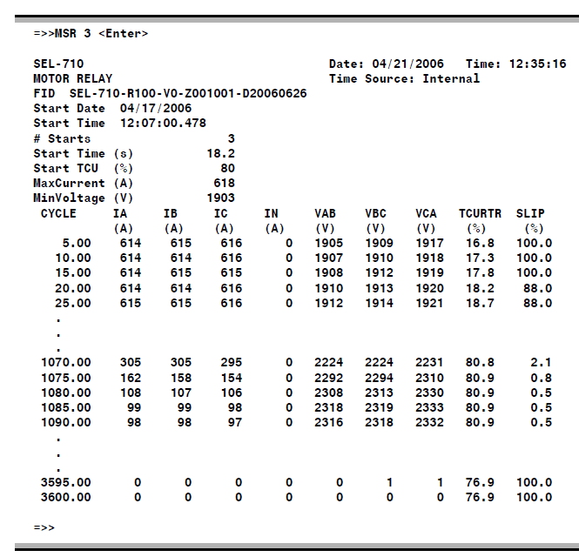
Threat
Statistics – Motor Starting(SEL)

Slide 13
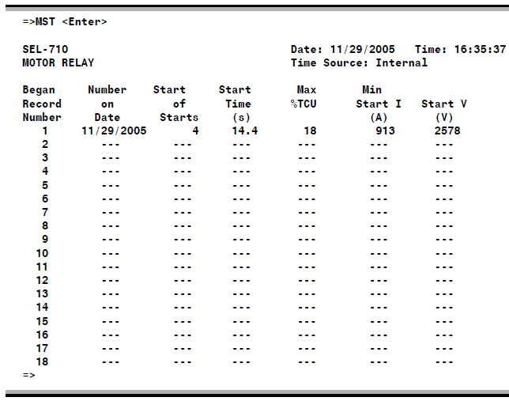
Threat
Statistics – Motor Start Trending(SEL)

Slide 14
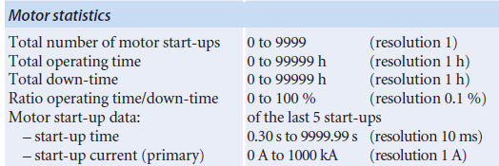
Threat
Statistics – Motor (SIEMENS)

Slide 15
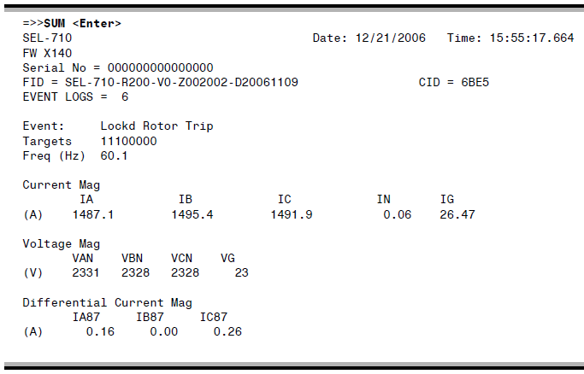
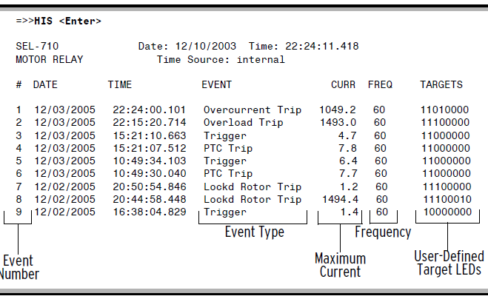
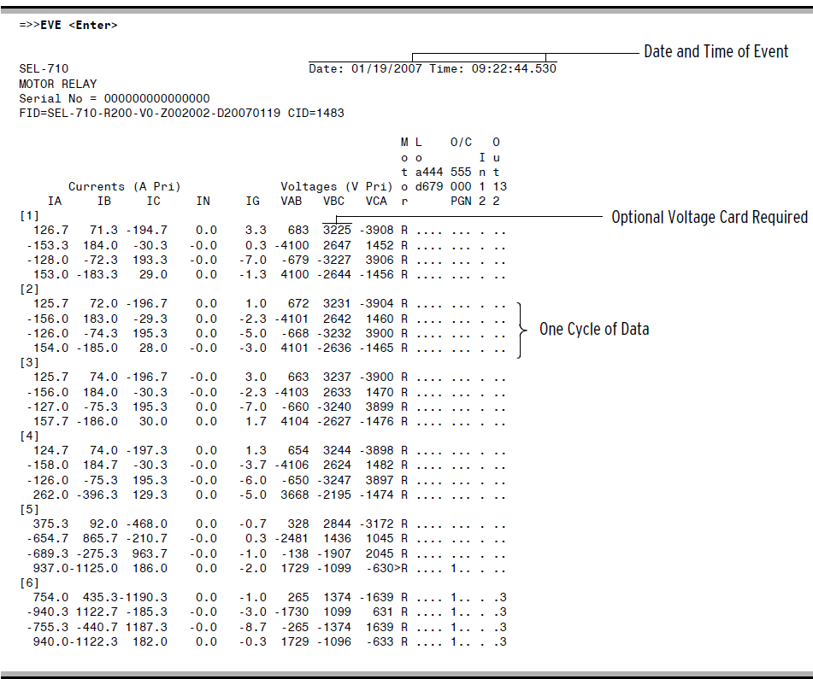
Threat
Event Handling(SEL)

Slide 16
Threat
Self Test and Troubleshooting – Synchronous Motor (GE)
The SPM has built-in test diagnostics to indicate that the relay is operating properly prior to start-up. The SPM also contains a test mode, which includes the following tests:
• Trip relay contacts
• System test
• Squirrel cage protection test
• Synchronization
• Power factor test
The system test performs a complete check of the internal memory, input-output devices and other system functions.

Slide 17
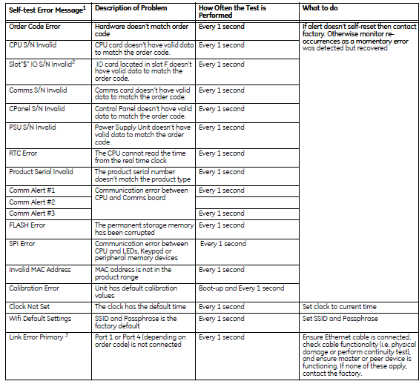
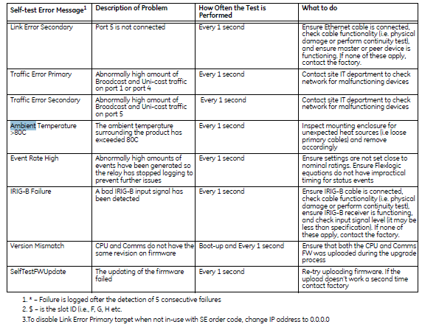
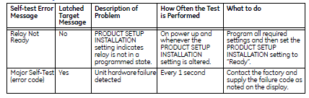
Threat
Self Test and Troubleshooting – Relay Self Test(GE)

Slide 18
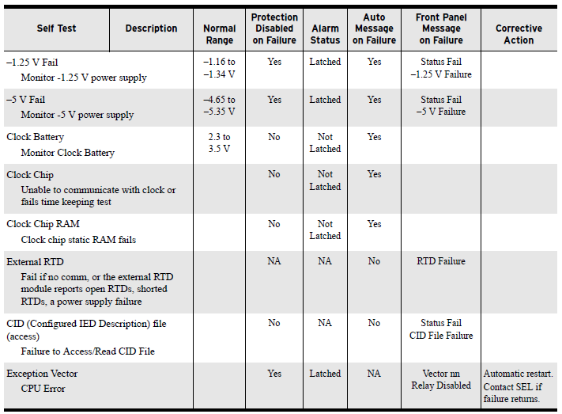
Threat
Self Test and Troubleshooting – Relay Self Test(SEL)

Slide 19
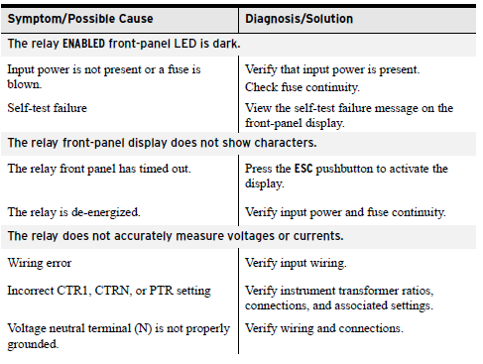
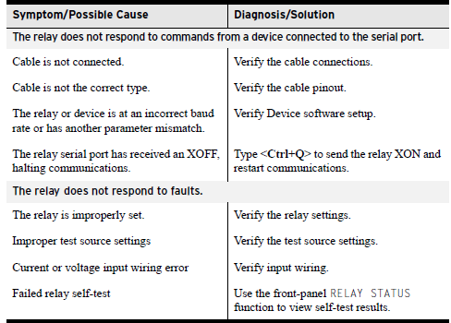
Threat
Self Test and Troubleshooting – Relay Troubleshooting (SEL)

Slide 20
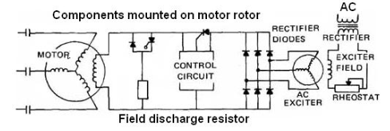
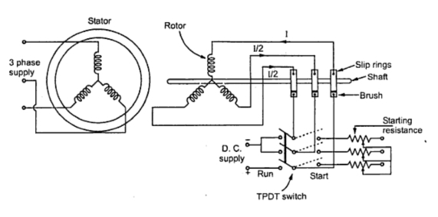
Threat
Synchronous Motor Control and Protection (GE,SEL, SIEMENS)
A synchronous motor operate in synchronism with applied AC voltage across its terminal. Under steady state condition there is no relative speed between rotor poles and rotating magnetic field produced by stator winding. Following are the type’s synchronous motor
Self-excited: Working on same principal as of induction motor except there is provision of locking the rotor poles with rotating magnetic field produced by stator current.
Self-excited synchronous motor protection is similar to induction motor.
Separately DC excited: This motor requires external direct current (DC) source to excite the rotor poles. As there is external DC source needed to excite the rotor, the direct current can be supplied from separate source or from DC generator directly mounted on motor shaft .
Starting method: Synchronous motors are not self-starting. First it requires external means (usually another induction motor) to reach very near to synchronous speed then excitation is applied. This method is seldom used because of the expense of extra motor.
Another method is to start the motor as to start the motor as induction motor. This is achieve by having squirrel cage type bar on rotor in addition to regular rotor winding. The motors achieve nearly synchronous speed (approximately 95% of full speed) and dc excitation voltage is applied to regular rotor winding.
Challenges
Following are few challenges for synchronous motor protection and control.
Synchronous motor protection and field breaker control (separately excited motor).
Measurement of rotor induced voltage frequency for excitation voltage closing (separately excited, slip ring).
Power factor regulation.

Slide 21
Threat
Synchronous Motor Control and Protection (GE,SEL, SIEMENS)
 | Motivation | REX 630/REX 620 * | GE –SPM | SEL 710 | SIEMENS 7UM62
Fault Type | Field over/under voltage | Y(4-20 mA signal) | Y (VDN module ) | Y (additional module) | Y (4-20 mA signal)
 | Field Over/Under current | Y(4-20 mA signal) | Y – (DCCT module) | Y (additional module) | Y (4-20 mA signal)
 | Loss of field | Y | Y | Y | Y
 | Out of step (Loss of synchronism) | Y | Y (Power factor method) | Y (VAR method) | Y (Impedance method)
 | Incomplete sequence ^{5*} | N | Y | N | N
 | Field winding over temperature | Y (RTD only) | Y (RTD + DCCT module) | Y (RTD only) | Y (RTD only)
 | Power Factor (Pull-Out) Protection¹* | N | Y | Y (but no control) | Y (but no control)
Measurement
 | Excitation voltage | 4-20 mA signal | Y |  | 4-20 mA signal
 | Excitation current | 4-20 mA signal | Y |  | 4-20 mA signal
 | Rotor resistance | N | Y
Control
 | Excitation breaker control and auto synchronization ^{2*} | No mention | Y | Y | Using two Bi
 | Reluctance Torque Synchronizing ^{3*} | No mention | Y | N | N
 | Power factor regulation | No | Y | N | N
 | Self-Tests and Diagnostics ^{4*} | No mention | Y | N | N

Slide 22
Threat
Synchronous Motor Control and Protection (GE,SEL, SIEMENS)
1* → Power Factor (Pull-Out) Protection: Motor pull-out protection is provided by a circuit which monitors the power factor and has a built in time delay to prevent inadvertent tripping on transients. Two modes of pull-out protection are available, re-sync mode and ride-thru mode. These modes will be initiated if the lagging power factor drops below the programmed set point, or if a line current surge occurs which is above four times the motor full load current.
Re-sync mode operation will cause the Field Application Relay (FAR) to remove the motor field excitation. The motor will continue to run with the field removed for the programmed power factor delay time. If re-synchronization does not occur within this time the trip relay will operate and the motor will stop.
In ride-thru mode the motor field excitation is not removed immediately. Instead, the SPM allows the motor to run for the power factor delay time. If the power factor dip or line current surge persists, the trip relay will operate and the motor will stop.
2* →Starting and Synchronizing: In slip ring motors, the SPM detects the rotor speed and angle from rotor terminal voltage and determines the correct time to close the field application relay based on the percent synchronous slip set point. This applies excitation to the motor field and opens up the field discharge resistor loop.
In brushless motors, the voltage is applied to the exciter after a preset programmable time elapses. Power factor pullout protection is then enabled. A contact (FCX) is also provided to signal automatic motor loading.
3* →Reluctance Torque Synchronizing: Reluctance torque synchronizing is when a lightly loaded synchronous motor pulls into synchronization before the rotor poles are externally magnetized. The SPM’s field application control responds by applying excitation if a motor synchronizes on reluctance torque.
5* → Incomplete sequence: In case after motor start, motor not reached to synchronous speed within preconfigure delay time.

Slide 23
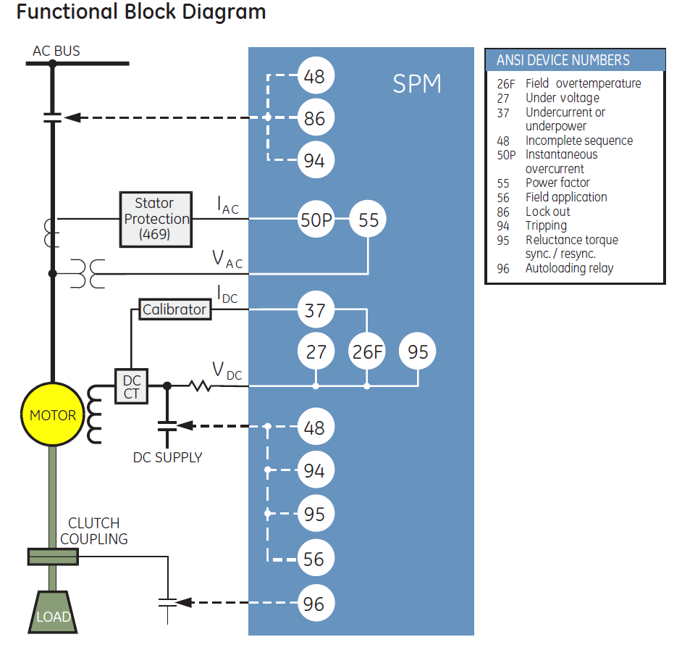
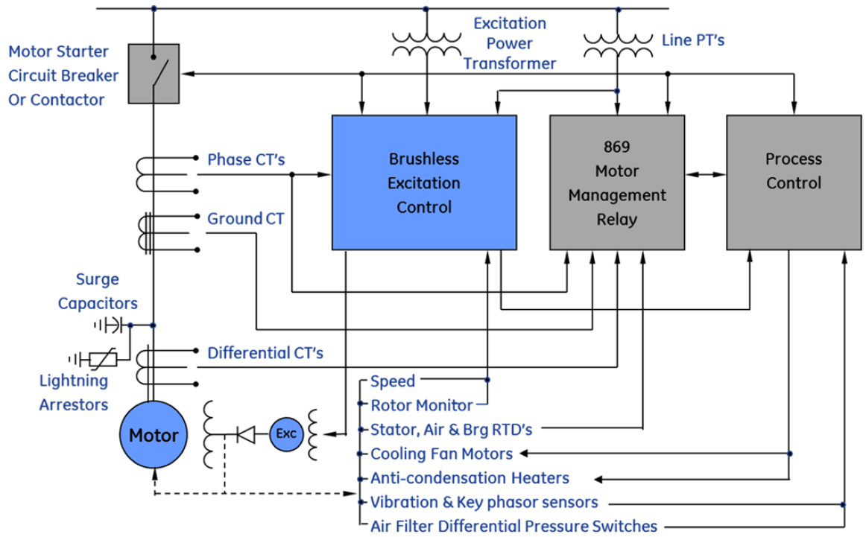
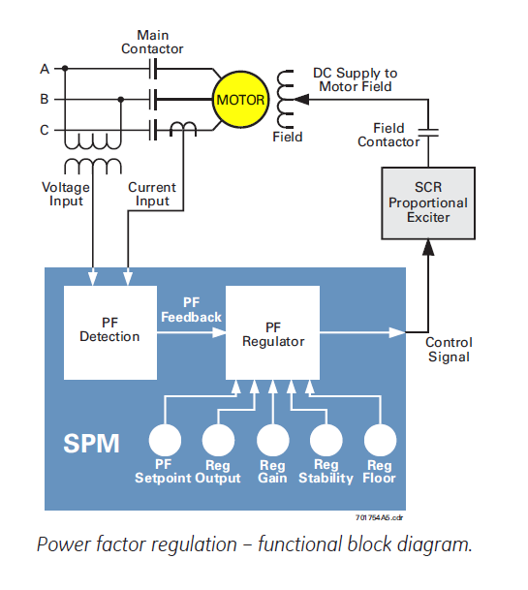
Threat
Synchronous Motor Control and Protection (GE)

Slide 24
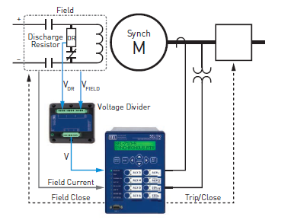
Threat
Synchronous Motor Control and Protection (SEL)

Slide 25
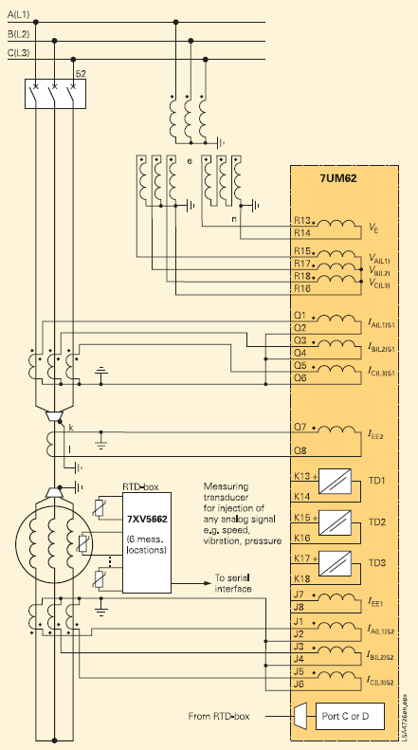
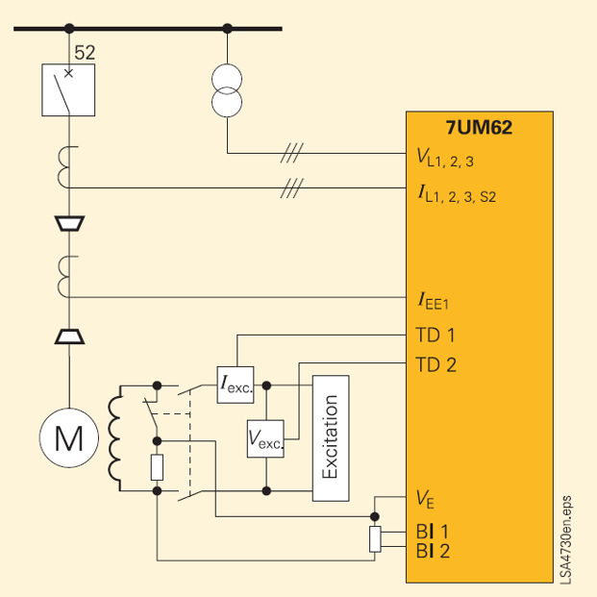
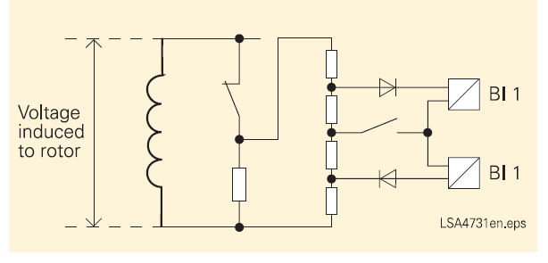
Threat
Synchronous Motor Control and Protection (SIEMENS)

Slide 26
Weakness
Differential Protection
Differential CT Connection
Thermal Overload
Hot and cold safe stall ratio (GE),
Stator temperature RTD bias (GE)
RTD box as external hardware.(SIEMENS)
Slip dependent thermal model (SEL)
Independent thermal model for stator and rotor (SEL)
Integrated approach (SEL)
Flexi Curve (GE)
Flexible Protection (SIEMENS)
Application Coverage – Intermittent load application note (SEL)

Slide 27
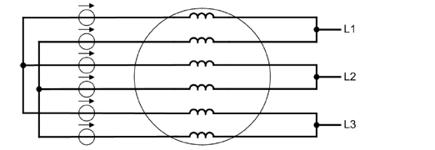
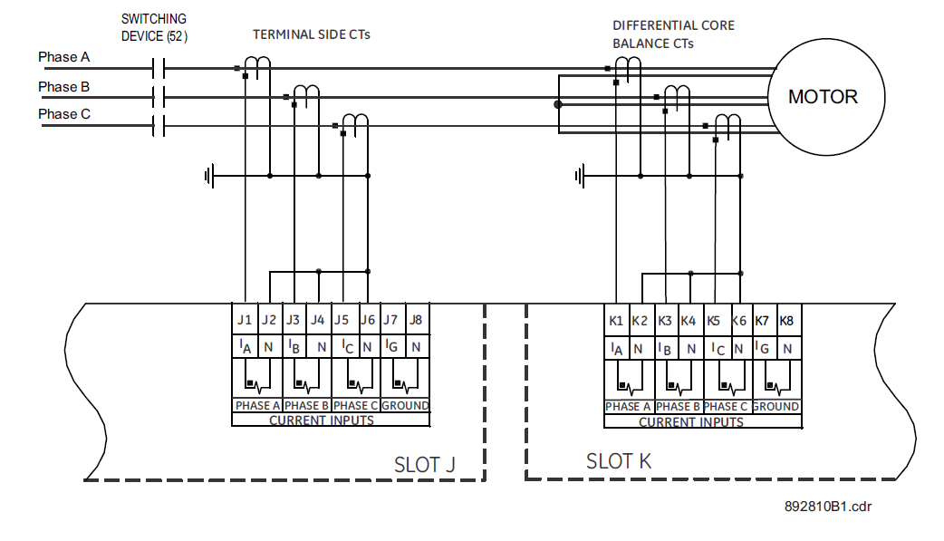
Weakness
Differential CT Connection
Motivation | REX 630 /REX 620 | GE - 869 | SEL 710 | SIEMENS 7UM62
Differential CT Internal summation | Y | Y | Y | Y
Differential CT Core balance | Y | Y (Figure 2 ) | Y | N ( Not mention)
DC restrain | Y | N ( No mention) | N ( No mention) | N ( No mention)
Longitudinal differential | Y | Y | Y | Y
Transverse differential | N | No Mention | No Mention | Y ( Figure 1 )
Figure 1
Figure 2

Slide 28
Weakness
Thermal O/L
Hot and cold safe stall ratio. (GE,SIEMENS)
Stator temperature RTD bias (GE
Integration of RTD box as external hardware (SIEMENS)
Slip dependent thermal model (SEL)
Independent thermal model for stator and rotor (SEL)
Integrated approach :Single curve take cares of Locked, Rotor, running overload, operation under unbalance current and too frequent or prolong starting(SEL)
Single thermal curve (SEL)
Hot and cold safe Stall ratio Setting (GE & SIEMENS) :→ Few motor manufacture provide this data and customer intention is use this data for thermal overload
Stator temperature RTD bias (GE) :→ Temperature bias characteristics is used for RTD (Figure )

Slide 29
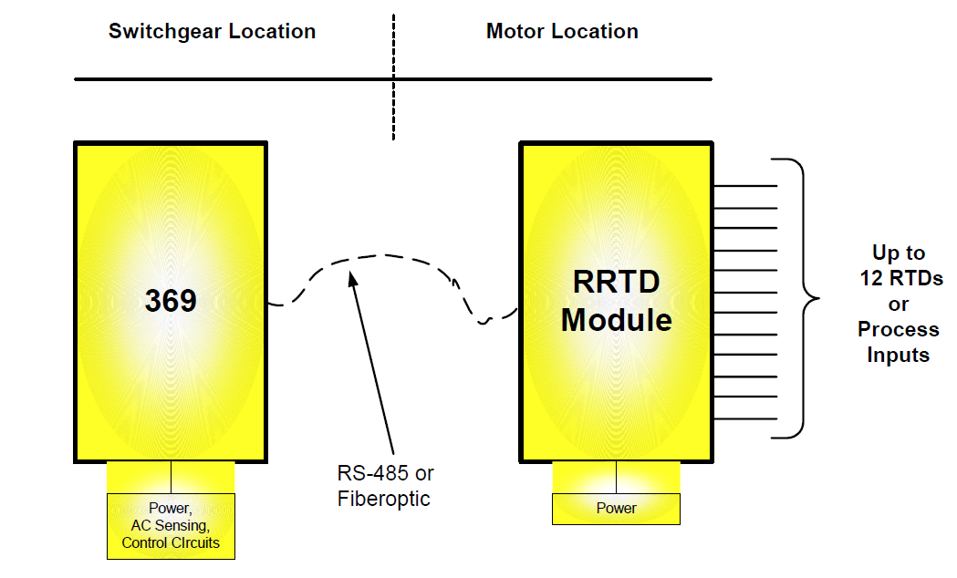
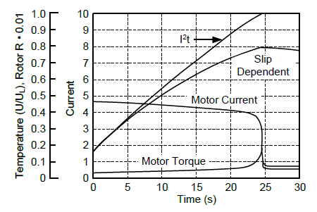
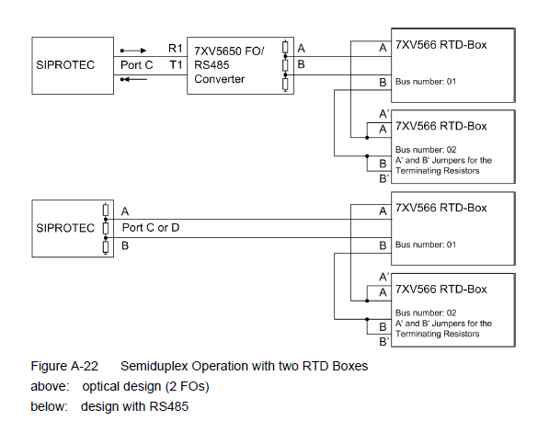
Weakness
Thermal O/L
Integration of RTD box as external hardware :
SIEMENS
Slip dependent thermal model (SEL):Starting time protection (useful for high inertia motor start)
Motivation : The starting current of an induction motor at the beginning of the start nearly equals the locked-rotor current magnitude but has a lesser heating effect during the start because rotor resistance decreases as the motor accelerates to rated speed.
Comparison between I²t vs slip dependent model
Note : Slip calculation
Voltage card needed
Design data : Locked rotor torque in pu.

Slide 30
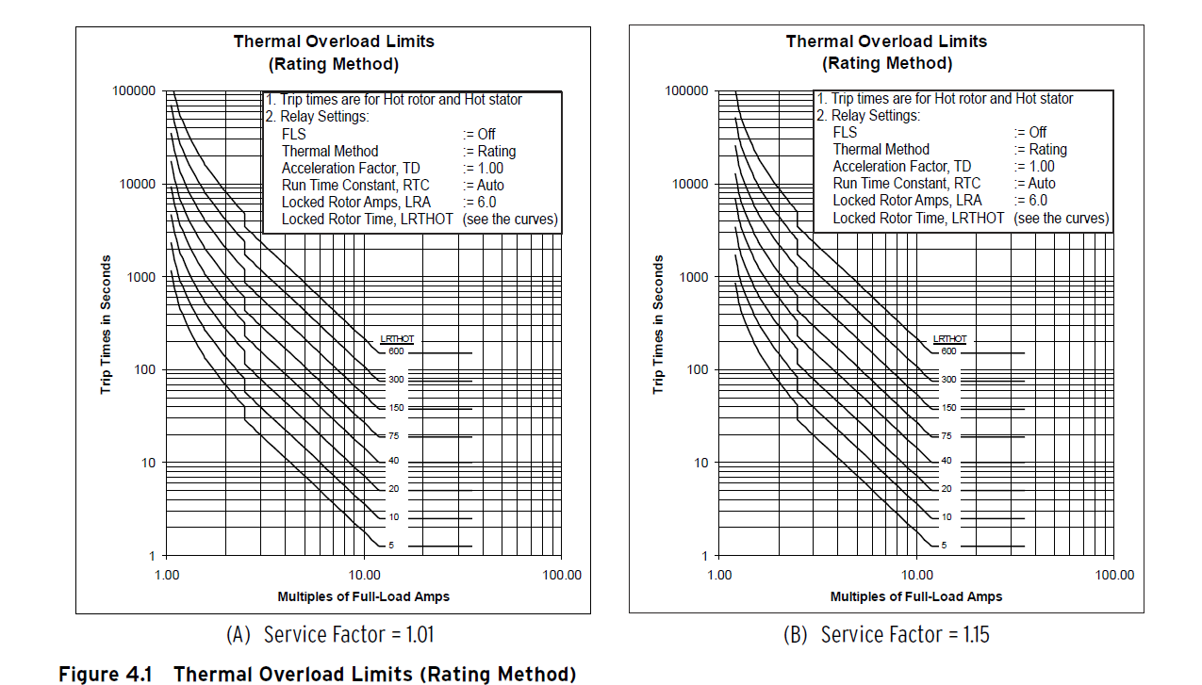
Weakness
Thermal O/L
Independent thermal model for stator and rotor (SEL)
Rotor model : (with optional voltage card): The rotor model dynamically weights the heating effect of each of the negative sequence and positive-sequence currents as a function of calculated slip. For high inertia applications where the motor acceleration time is longer than the locked rotor time, this feature avoids tripping during a start.
Rotor Model (without optional voltage card): Weights the heating effect of negative-sequence current as five times the heating effect of positive-sequence currents when the motor is running (weights them equally when the motor is starting).
Stator Model: Weights the heating effects of positive- and negative-sequence current equally when the motor is starting or running.
Integrated approach (SEL)
Locked Rotor Starts
Running Overload
Operation Under Unbalanced Currents
Too Frequent or Prolonged Starting
Single thermal curve (SEL)

Slide 31
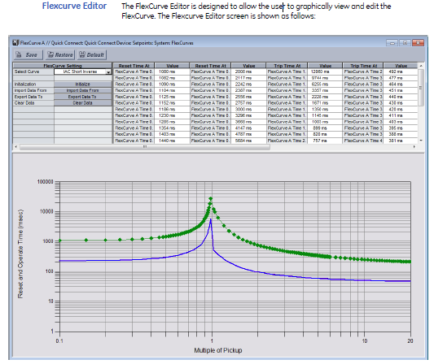
Weakness
Flexi Curve (GE)
Up to 4 flexi curve can configure
Integrated approach (SEL)
Locked Rotor Starts
Running Overload
Operation Under Unbalanced Currents
Too Frequent or Prolonged Starting
Single thermal curve (SEL)

Slide 32
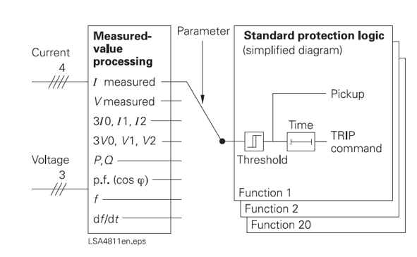
Weakness
Flexible Protection (SIEMENS)
Integrated approach (SEL)
Locked Rotor Starts
Running Overload
Operation Under Unbalanced Currents
Too Frequent or Prolonged Starting
Single thermal curve (SEL)

Slide 33
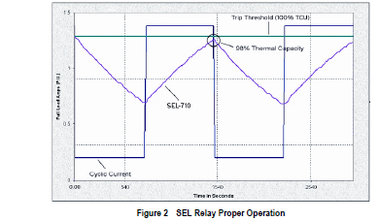
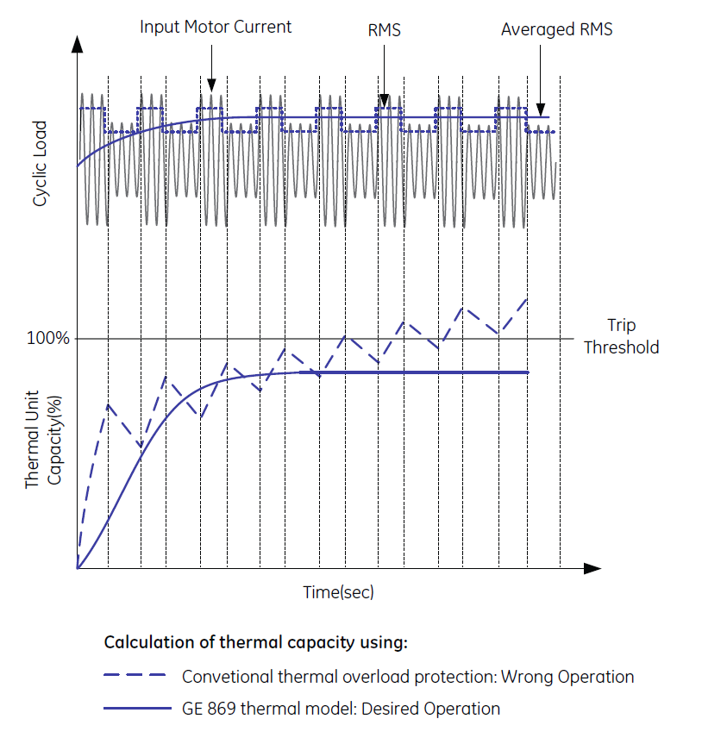
Weakness
Application Coverage – Intermittent load application note (SEL,GE)
Diverse application in industrial setup need electrical motors of different duty cycle. Some motor needs to run continuously while others run for some time and rest for most of time. Few applications need the cyclic overloading (with respect to motor rating) before the motor thermal limit violates.
Example are crane drives, pressing, and cutting, drilling machine, coal crusher and mine hoist.
Most of above applications motor rating is lower than peak time need. Hence it is very important that , thermal replica almost follow the actual motor heating and cooling stages otherwise either the motor gets damaged or unnecessary tripping occurs during intermittent loading.

Slide 34
Opportunities
Variable Frequency Drive Protection as Unit (SEL,GE )
Backspin or Coast Down Protection
Inter Turn Short Circuit Protection
Transient or Intermittent Earth Fault ( SIEMENS)
Thermal O/L– Heating Behavior : Diabatic and Adiabatic
Advance Monitoring and Diagnostics
Torque and Speed Measurement
Bearing Condition Deterioration

Slide 35
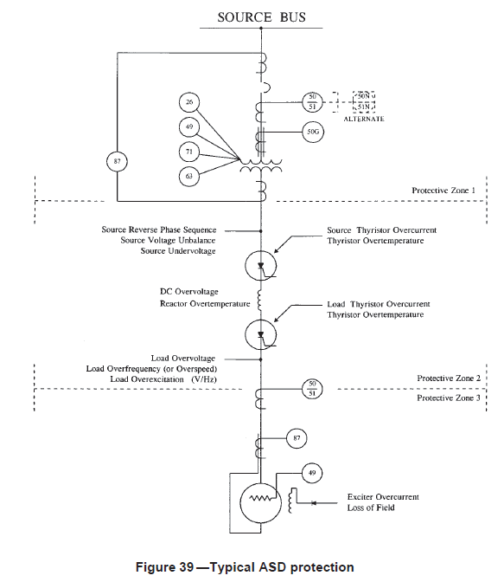
Opportunity
Variable Frequency Drive Protection as Unit
As per IEEE C37.96-2012: Section 6.3.1 Adjustable speed drive (i.e. VFD) system protection can be divided into following three zone of protection
Zone 1 : input transformer , Zone 2 : Power electronics and Zone 3 : Motor
VFD as all zone protection not present in any of the competitor document / application although Zone 3 protection available (SEL,GE)
Challenges
Zone 3 : Frequency adoptive Protection
Zone 1 : Frequency adoptive not needed
By pass switch control needed
Zone 3 Protection setting should change

Slide 36
Opportunity
Back Spin or Coast Down Protection
In pumping application if pumping the fluid upside (example pumping fluid from one tank to another tank, sump pump, bore well pump etc.) and pump stop, first pump impeller stops and immediately starts rotating in opposite direction because of fluid in opposite direction (Up to down side) and continue to rotate opposite till all fluid flown in downward direction.
If motor (or pump) starts when it is still rotating opposite direction, it will draw more than locked rotor current this forces will either trip the motor or damage it.
Following are few methods / procedure to avoid the motor start at back spin condition.
Mechanical brake to stop the motor.
Shaft position encoder
Installing the NRV at inlet of pump to avoid the back flushing the liquid.
Zero speed switch
Time delay timer: Once motor stop, timer start and disable the start of the motor until timer expires. (Drawback: User should determine the back spin time of pump application).

Slide 37
Opportunity
Inter Turn Short Circuit Protection
The short circuit between two ( multiple) turn of same phase or different phase which are in close proximity to each other is known as inter turn fault. Cause for interterm fault is insulation failure. If not identified in due time this can evolve to earth fault or phase to phase fault.
Inter turn fault in same phases are not detected by differential protection.
No product offering have inter turn fault detection for motor application. ( for other application i.e. transformer and generator winding inter turn fault available)

Slide 38
Opportunity
Transient or Intermittent Earth Fault ( SIEMENS)
Motivation | REX 630 /REX 620 | GE 869 | SEL 710 | SIEMENS 7UM62
Residual or zero sequence current based earth fault | Y | Y | Y | Y
Residual or zero sequence voltage based earth fault | Y | Y | Y | Y
Sensitive earth fault ( core balance CT) | Y | Y CT : 50/0.025 | Y CT : 10/1 | Y CT : 60/1
Transient or intermittent earth fault ( Io and Uo – Transient detection very fast) | Y | N | N | Y
High-impedance-based restricted earth-fault protection (IDo – more sensitive than normal differential) | Y | No Mention | Y | Y
low-impedance restricted earth-fault protection (I_A,I_B,I_C and Io) | Y | Y | Y | Y

Slide 39
Opportunity
Thermal O/L– Heating Behavior : Diabatic and Adiabatic
Diabatic behavior ( I < 2*Ir) : Thermal model consider both heating as well as cooling ( first order differential equation ) in motor running state.
Adiabatic behavior (I>2*Ir) : Thermal model consider only heating.
Motivation
No competitor mention this aspect
Only in ultra low end relays (REX605) have this feature.

Slide 40
Opportunity
Advance Monitoring & Diagnostics (Sensor Less)
Speed Measurement
Speed measurement in induction motor particularly useful for slip detection , which in turn will useful for optimising the thermal model for overload detection for complete operation cycle of motor ( Starting , running and block rotor condition )
Air Gap Torque measurement
Torque measurement / estimation can be useful for condition monitoring of driven process i.e. gear box , belt conveyor pump etc.
Bearing Condition Deterioration
Bearing failure accounts for almost 50 % of motor failure compare to rotor cage problem . Bearing failure in running condition of motor lead to much bigger problem ( rotor touches stator , coupling failure etc.) compare to bearing failure itself.

Slide 41
Strength 1 of 2
Inverse Time Curves.
ABB | GE | SEL | SIEMENS
RI – RD curves Programmable curves | IAC curves I2t and I4t | - | -
Differential Protection DC restrain.
ABB | GE | SEL | SIEMENS
Y | N ( No mention) | N ( No mention) | N ( No mention)
Load Profile Recording → with click of clock
ABB | GE | SEL | SIEMENS
Y | N ( No mention) | N ( No mention) | N ( No mention)

Slide 42
Strength 2 of 2
Thermal O/L – Ambient temperature consideration in thermal model
ABB | GE | SEL | SIEMENS
Y | N ( No mention) | N ( No mention) | Y

Slide 43
Weakness of Competitor
GE :
Thermal O/L – Load filter interval :Setting is used for device level
Current and power factor average from 1 to 32 cycle
Advantage Use for intermittent load and VFD application
Disadvantage – Increase in trip and alarm time
Motor start protection: Setting Istart and tstart
Disadvantage – Issue at reduced voltage start

